Slide 1


Frito Lay Attrition Analysis
William Arnost
DDS Analytics

Slide 2
Objectives
Identify the major factors driving attrition
Look at job role specific trends
Create a model to predict Attrition and Monthly Income

Slide 3
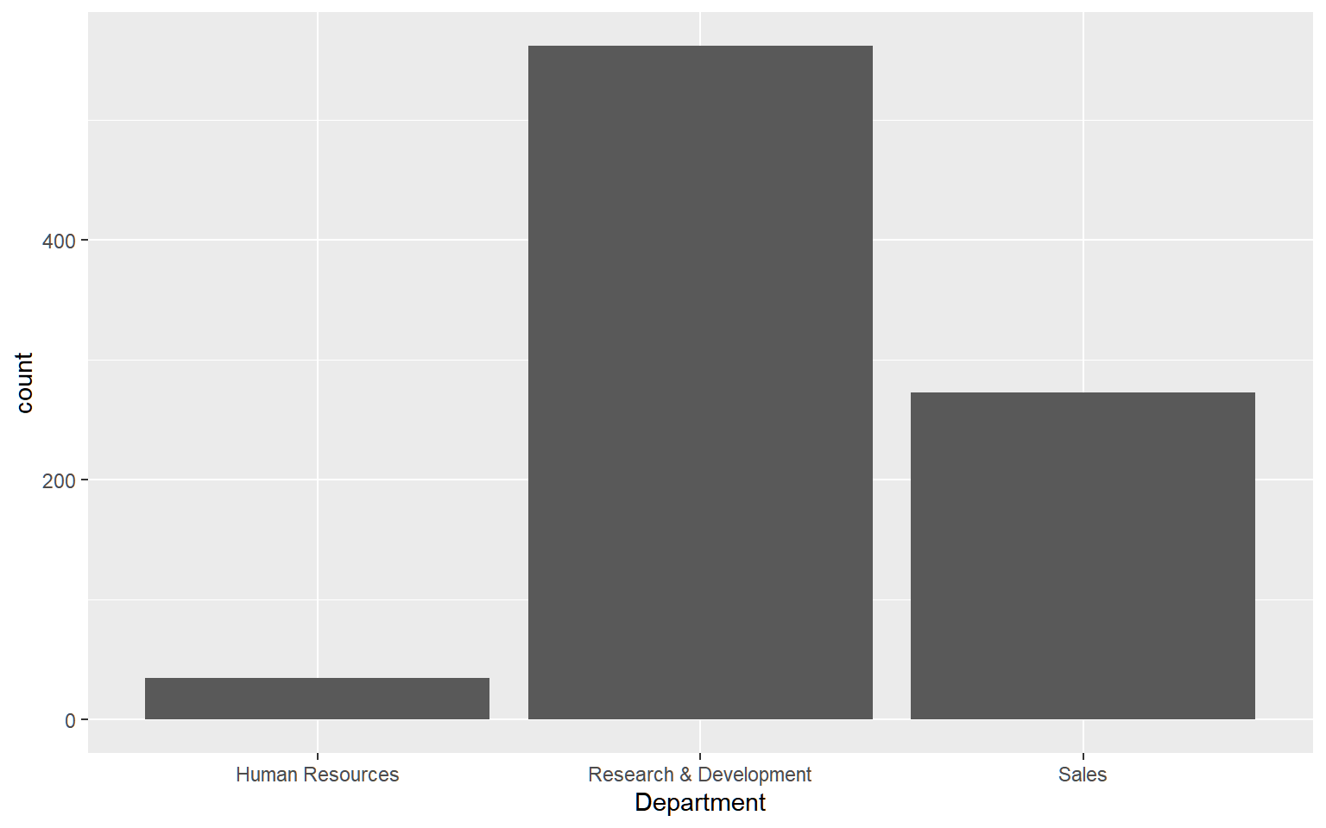
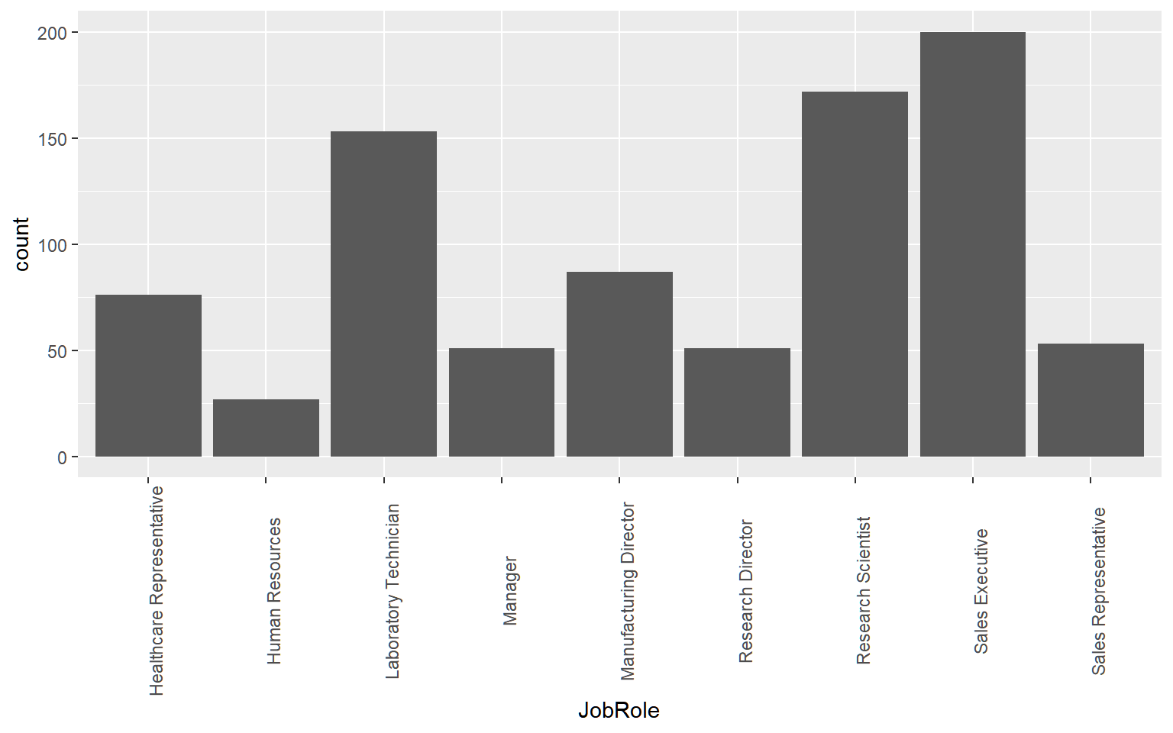
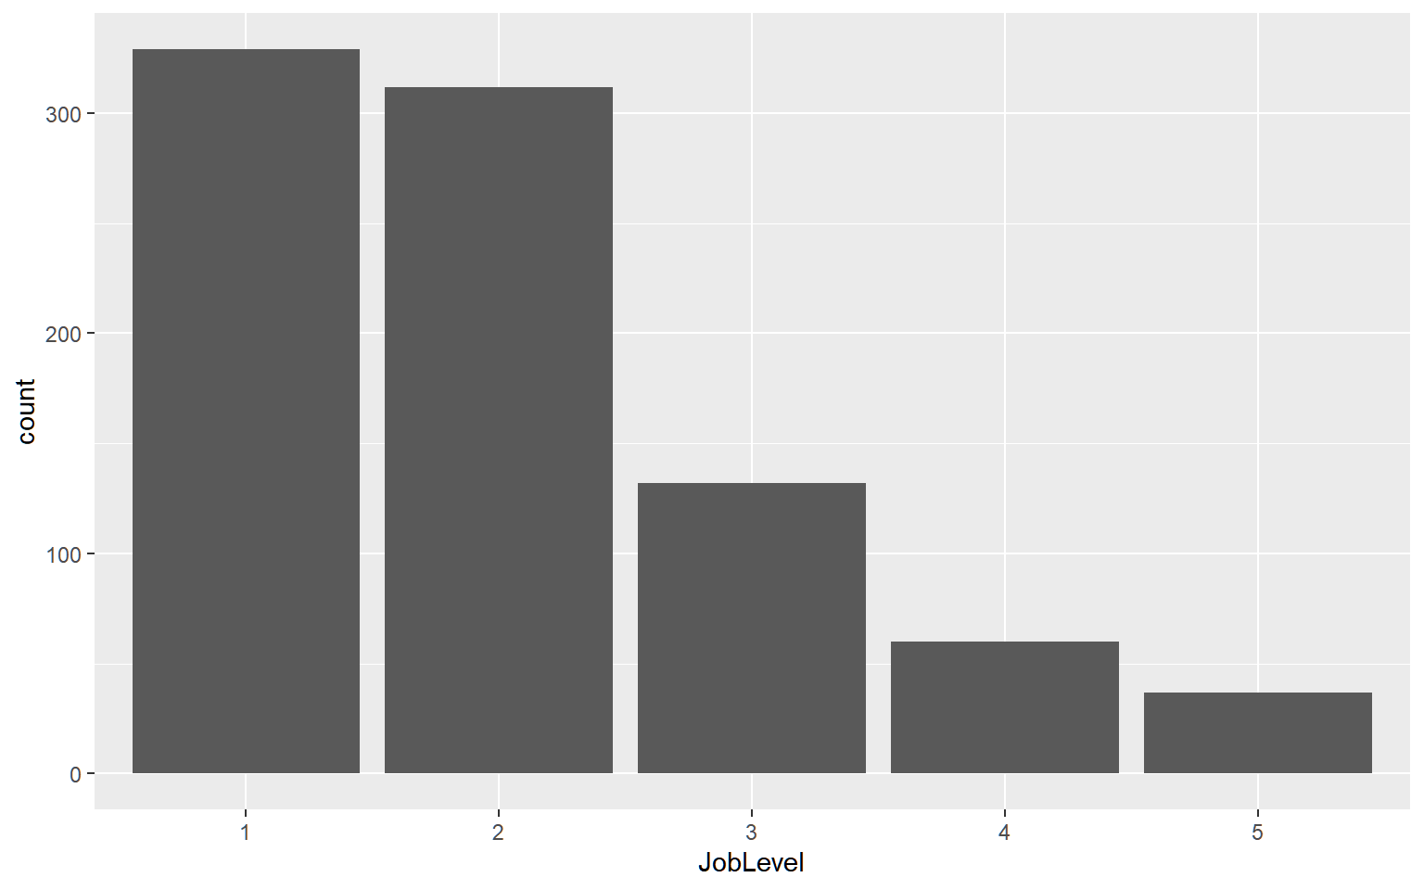
The Data
Employee Count by Department
Information on 870 Employees
36 Variables
3 Departments
9 Job Roles
5 Job Levels
No Missing Data
16% Overall Attrition Rate
Employee Count by Job Role
Employee Count by Job Level

Slide 4
Job Role Trends

Slide 5
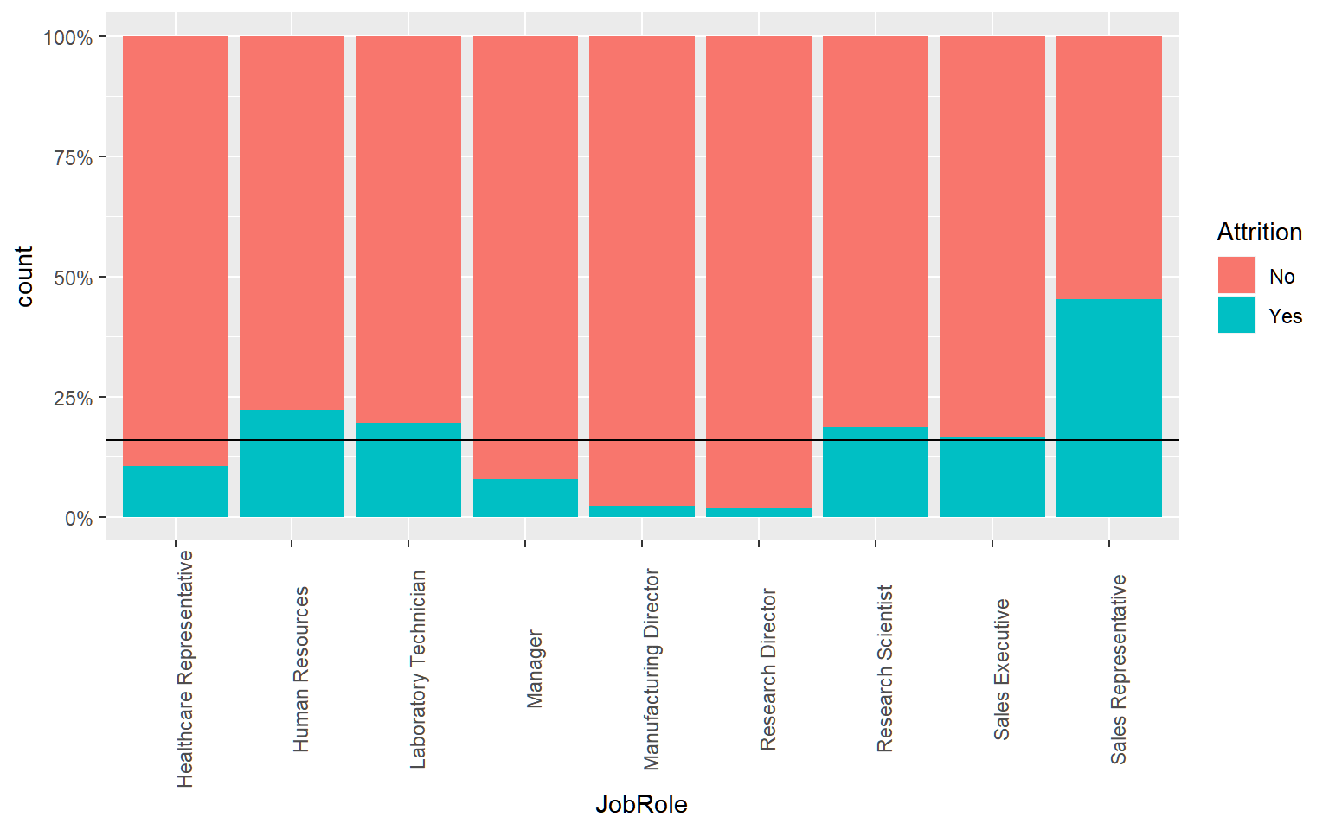
Attrition Rates by job role
Population Average
Attrition

Slide 6
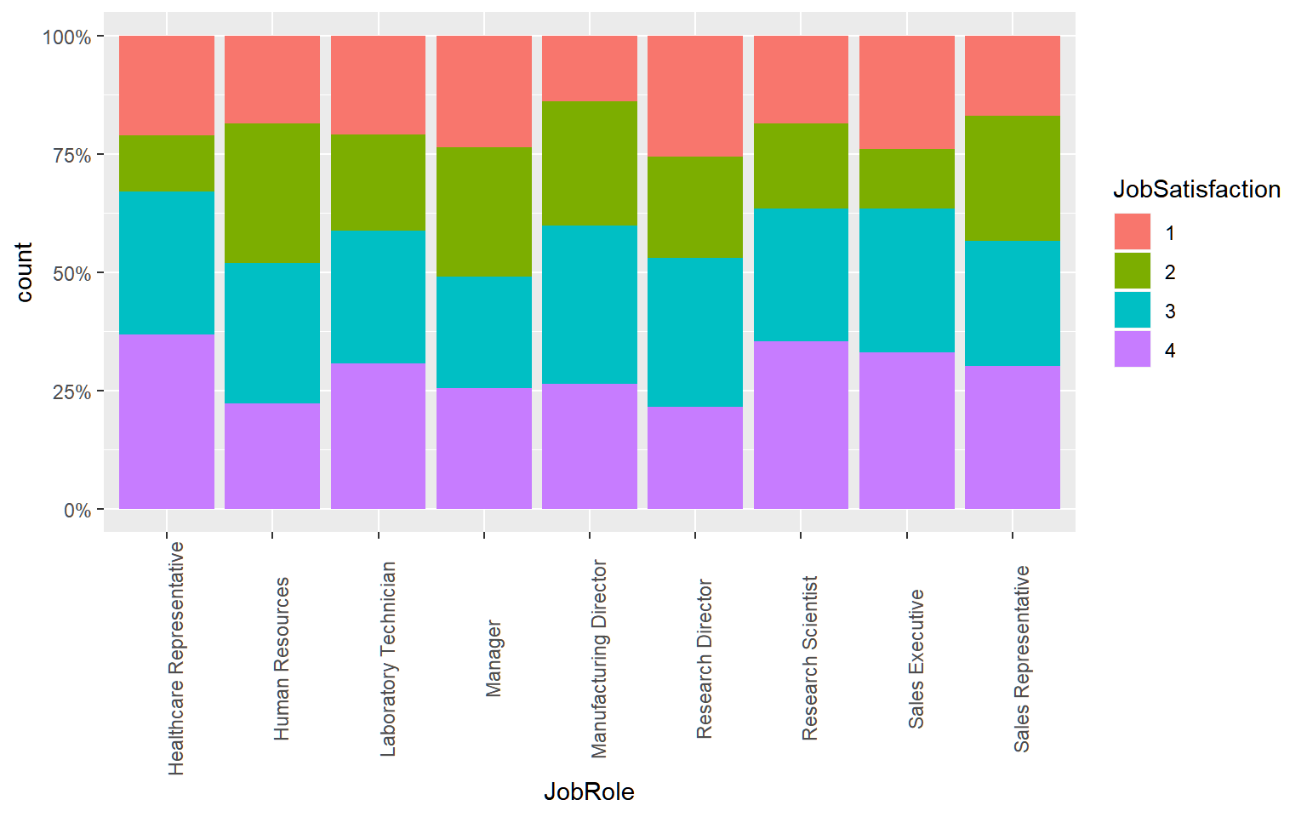
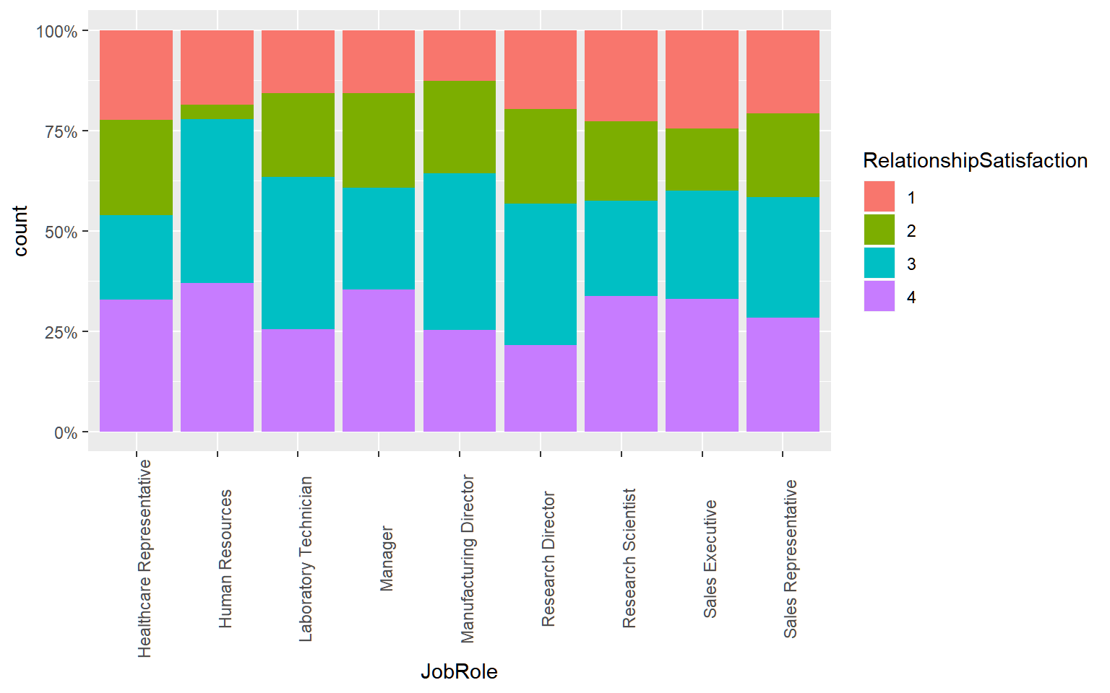
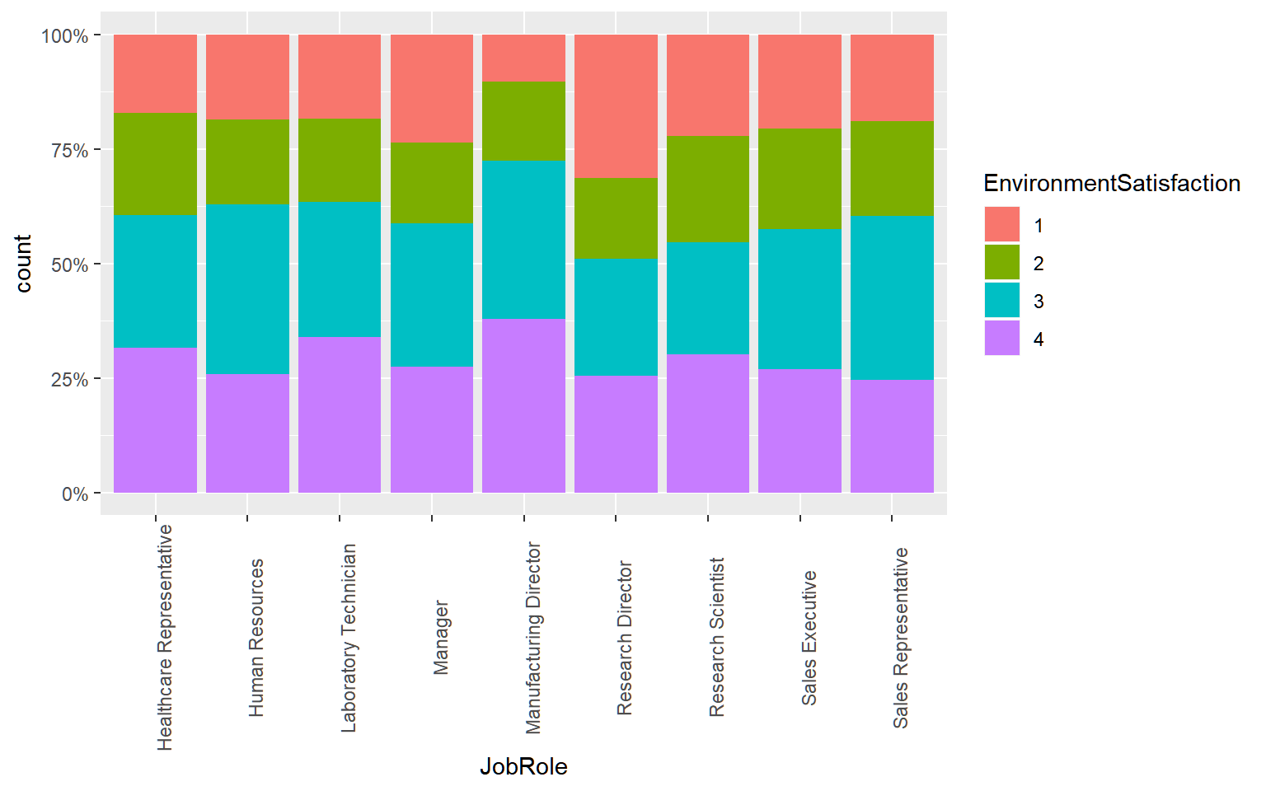
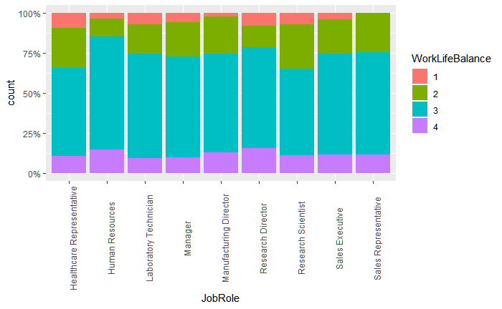
Satisfaction by job role
Job Satisfaction
Relationship Satisfaction
Environment Satisfaction
Work Life Balance

Slide 7
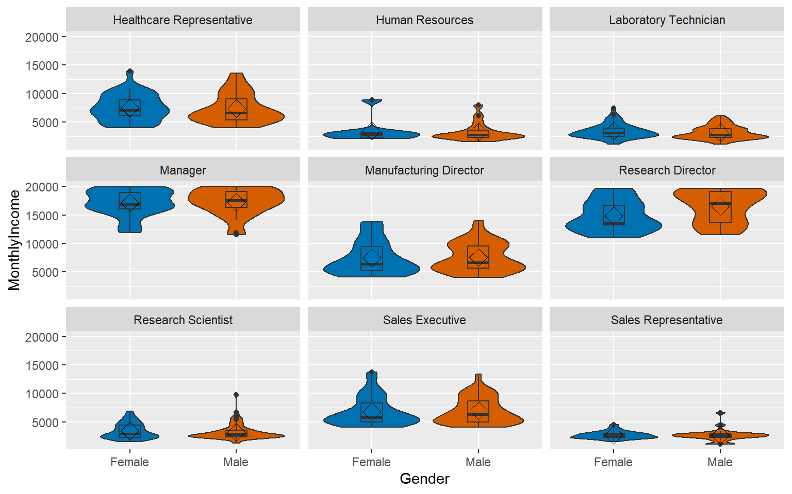
Income by Gender and Job Role
Job Role has a strong influence on income
Research Director seems to have a larger income for men vs women. This difference is significant with a p-value of 0.046

Slide 8
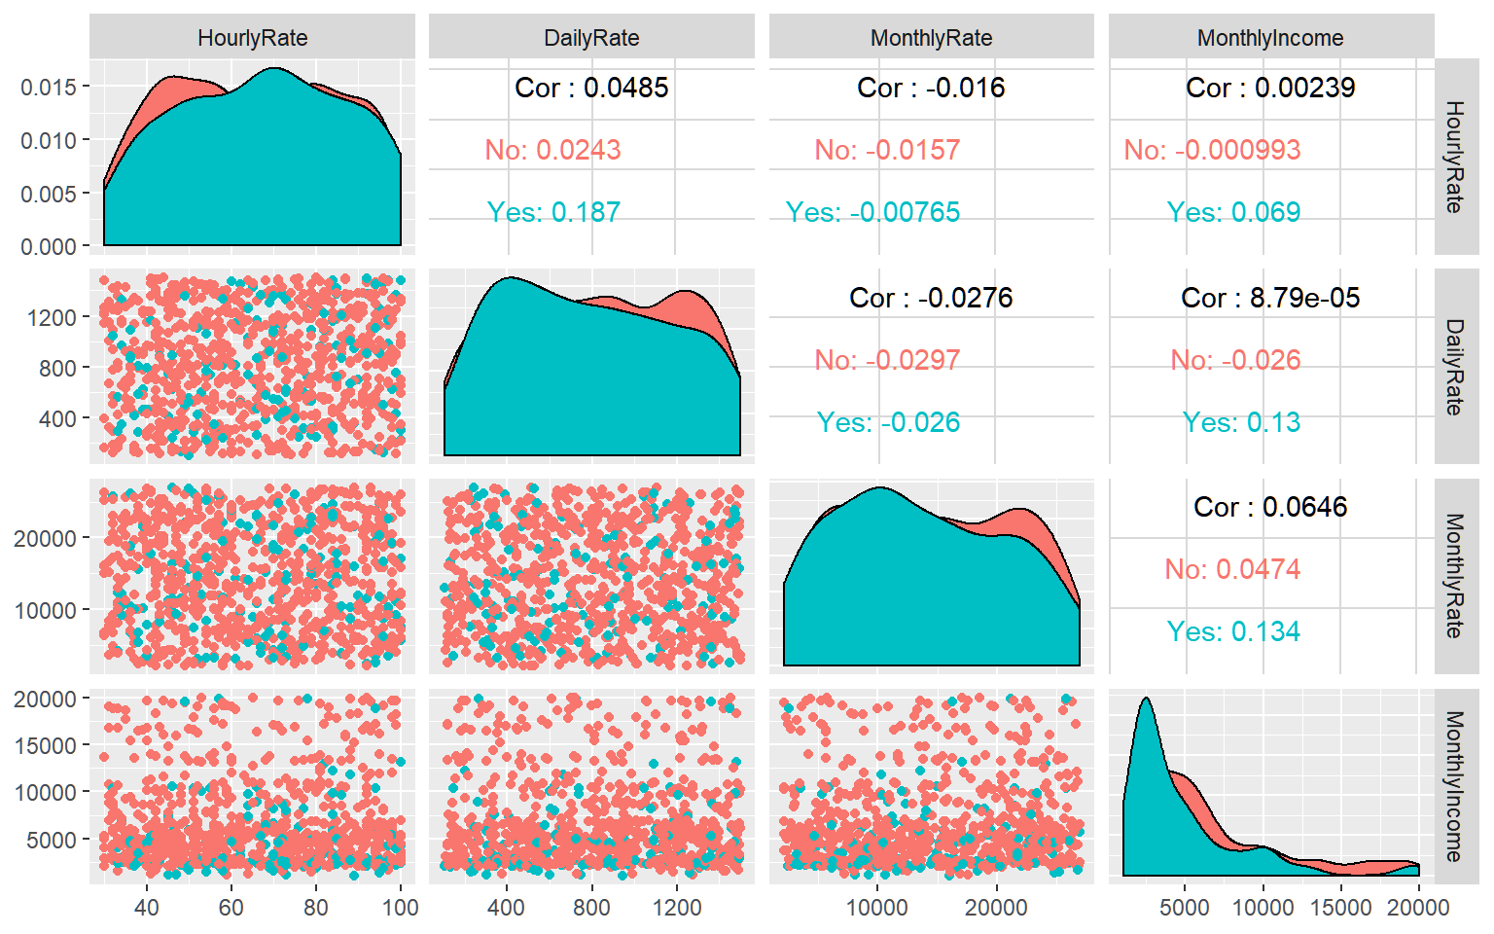
Rate Variables
Pairs Plot showing correlation (top right), Attrition density (diagonal), and bivariate scatter plots (lower left)
The Hourly, Daily, and Monthly rate variables do not appear to be related to each other, Monthly Income, or Attrition
Since these are not related to our variables of interest, we will ignore them for modeling until we have more information

Slide 9
Factors influencing Attrition

Slide 10
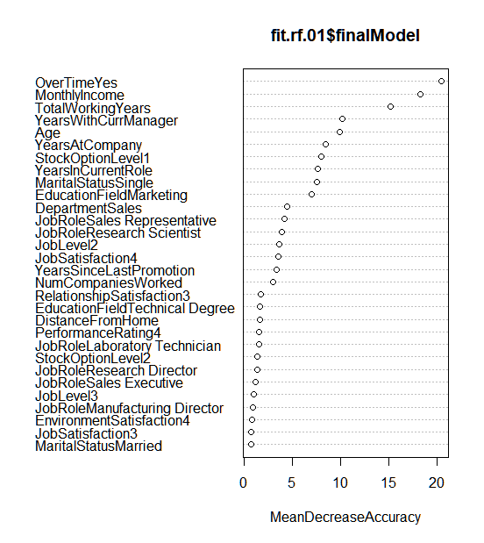
Variable Importance
Variable Importance
Over Time, Monthly Income, and Total Working Years seem to be the most important factors for Attrition

Slide 11
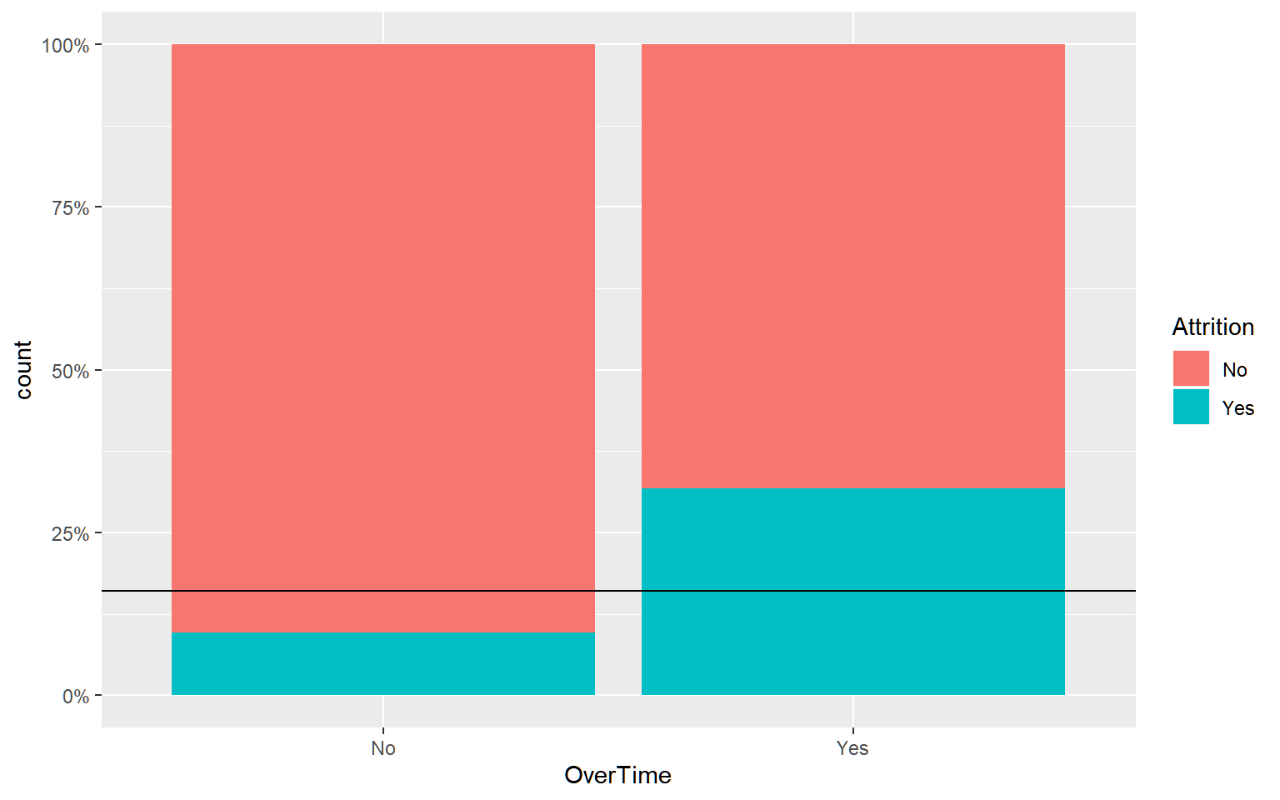
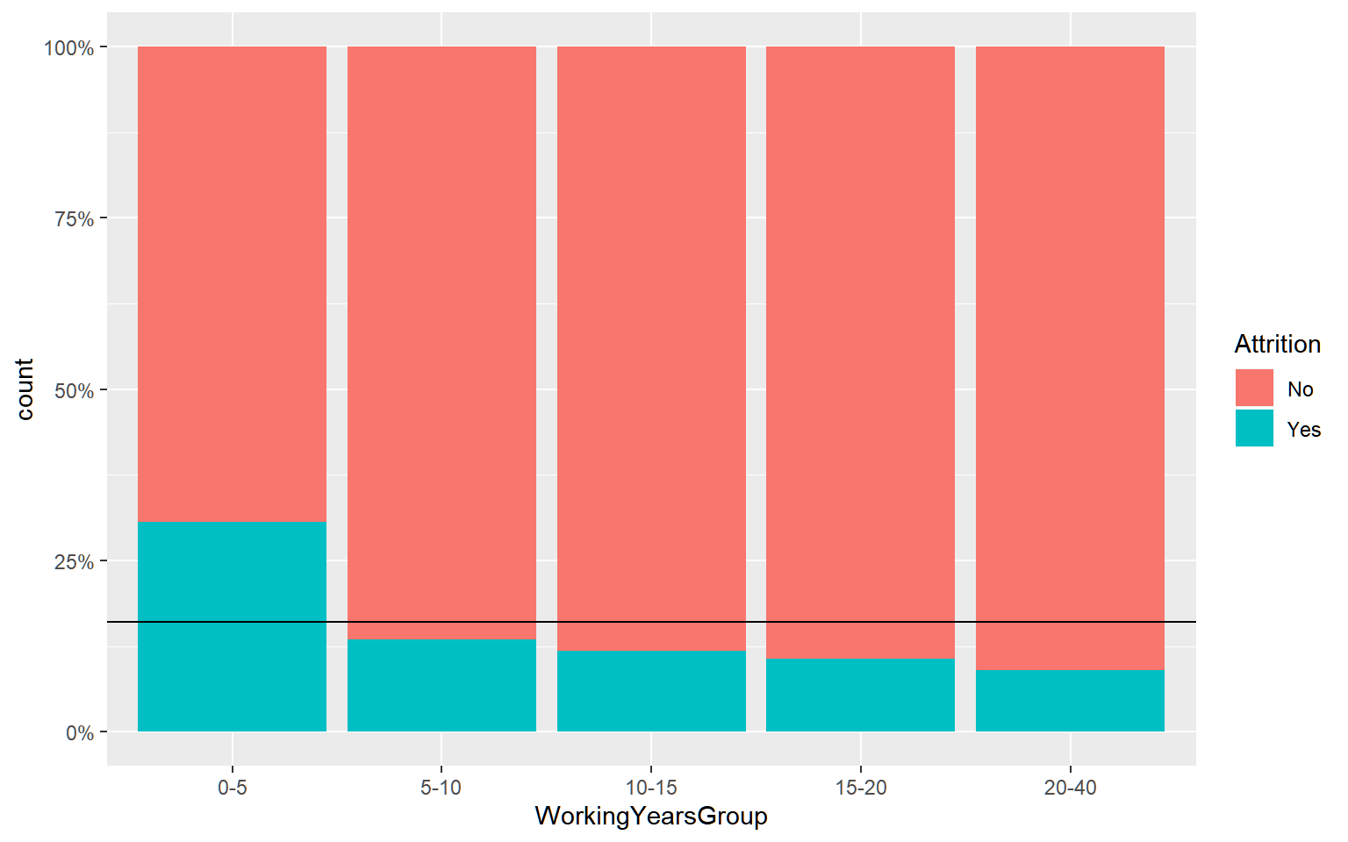
Overtime and Working years
Over Time Attrition Rates
Employees working over time leave at roughly 3x the rate as those not working over time
Employees who have been in the workforce 5 years or less leave almost 2x the population rate of 16%
Population Average
Attrition
Attrition Rates by Working Years
Population Average
Attrition

Slide 12
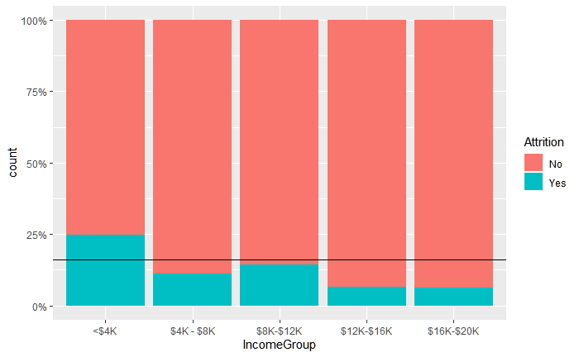
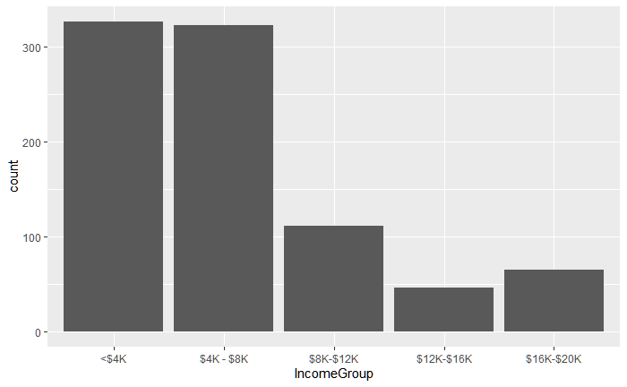
Monthly Income
Attrition by Income Group
Employees making $4,000 or less leave at an above average rate
Employees at this income level make up 37.5% of the total employee base
Population Average
Attrition
Employee Counts by Income Group

Slide 13
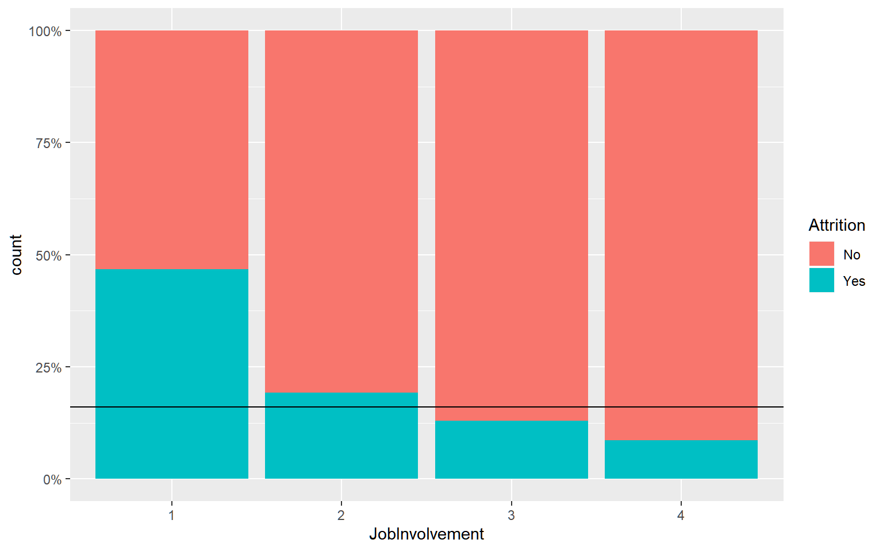
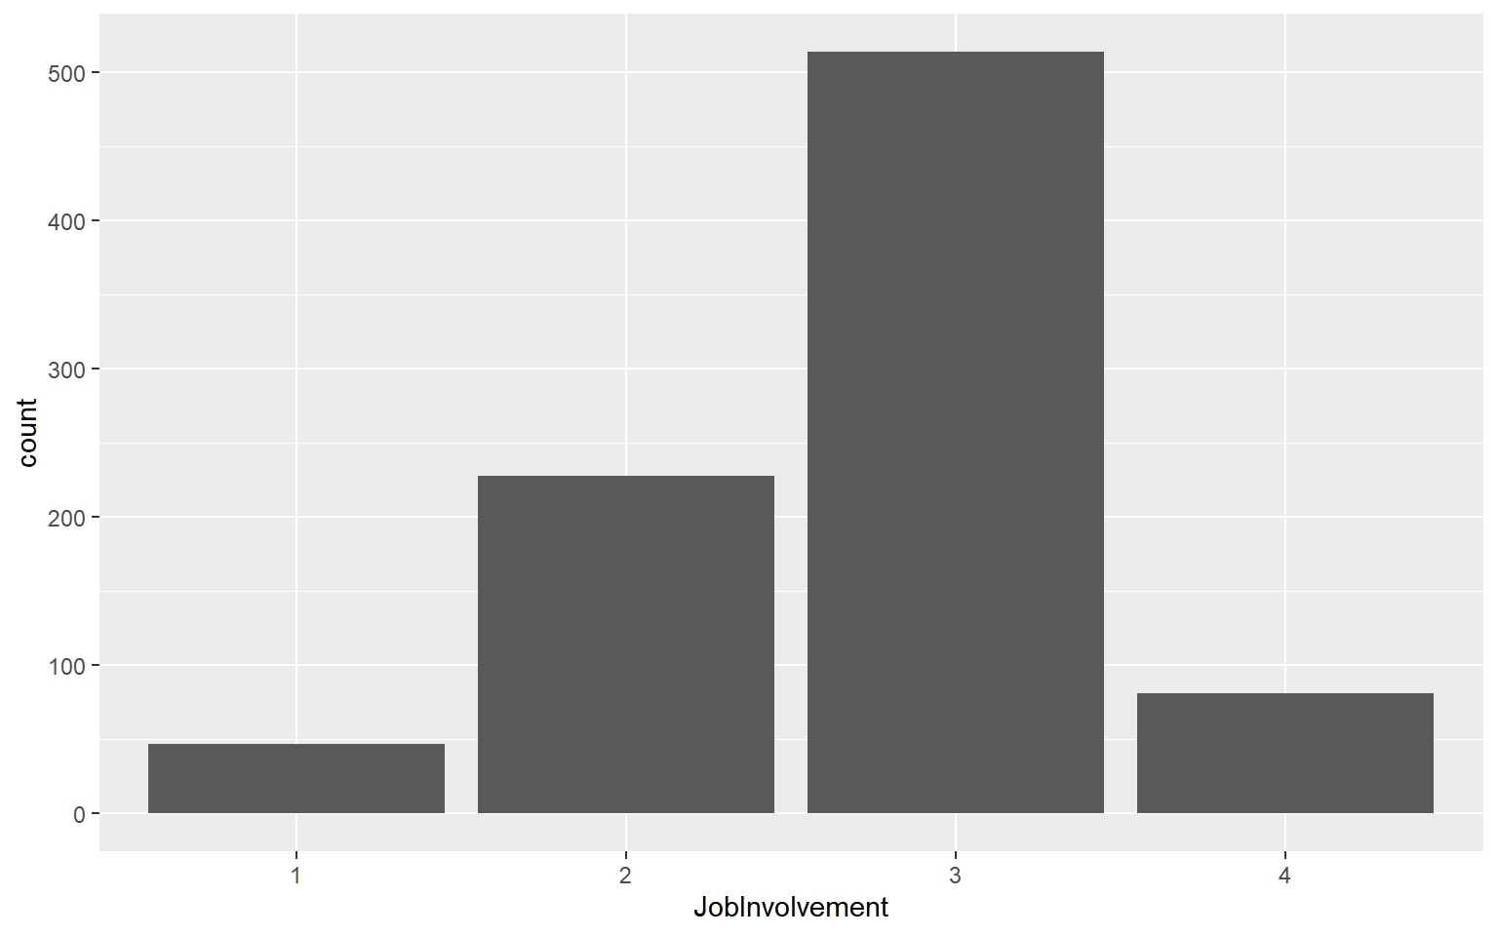
Job Involvement
Attrition by Job Involvement
Those with the lowest job involvement have a much higher attrition rate
They make up a very small portion of the sample population
Population Average
Attrition
Employee Counts by Job Involvement

Slide 14
Model Results
Attrition
Monthly Income

Slide 15
Attrition
Naïve Bayes
Variables: Over Time, Marital Status, Stock Option Level, Job Level, Years In Current Role, Monthly Income, Job Involvement, Working Years Group
Sensitivity: 0.70
Specificity: 0.69
Random Forest
Variables: Over Time, Marital Status, Stock Option Level, Job Level, Years In Current Role, Monthly Income, Job Involvement, Working Years Group
Sensitivity: 0.94
Specificity: 0.26

Slide 16
Monthly Income
Multiple Linear Regression
Variables: Job Role, Job Level, Total Working years, Business Travel
RMSE: $1129
Random Forest
Variables: Job Role, Job Level, Total Working years, Business Travel
RMSE: $1109

Slide 17
Conclusions

Slide 18
Conclusions
Over Time, Monthly Income, and Total Working Years are the most important factors for attrition
Job Level, Job Role, and Total Working Years are important for Monthly Income
Sales Representatives report the highest attrition
Manufacturing and Research Directors report the lowest attrition
More Info Available at: https://github.com/warnost/CaseStudy2

